Slide 1

University of North Texas
ADTA 5130 Data Analytics Team 15
Flight Price Prediction
By: Biniam Abebe
March 2024

Slide 2
Content
Introduction
Data Description
Exploratory Data Analysis (EDA)
Research Questions
Analysis and Observation
Hypothesis Testing
ANOVA Test
Regression Analysis
Reference

Slide 3
I. Introduction
Many passengers who wish to book a ticket wonder which airline or when to choose.
Determining the best time to buy a plane ticket can be difficult when little information about future pricing fluctuations is available. (Abdella and others, 375–391).
Forecasts of demand determine how much airlines should charge.
Airlines need to efficiently manage demand because there are only so many seats on an airplane. For instance, airlines may increase costs to reduce seat sales when demand outpaces capacity.
Passengers can use these dynamics to forecast future airfare patterns and make well-informed choices. Predicting the cost of a flight depends on several parameters, such as its duration, destination, source, and arrival time.

Slide 4
Objective
Flight price prediction is critical for the agency and customers to purchase tickets with optimized prices and at the right time.
We will use the dataset provided for the spring 2024 Airline with flight prices for various airlines between different destinations.
To Solve the problem, one will do exploratory data analysis based on the EDA and questions explored. Hypotheses will be developed to create predictive models.

Slide 5
II. Data Description
First, look at the overall dataset. It has 10,000 samples/records 22 features/variables, eight numerical features, and 14 categorical features.
 | Count | Mean | Std | Min | 25% | 50% | 75% | Max
Distance | 10000.0 | 4002.7 | 2290.7 | 100.5 | 1994.9 | 3977.8 | 5960.4 | 7999.6
FlightDuration | 10000.0 | 8.0 | 4.0 | 1.0 | 4.5 | 8.0 | 11.6 | 15.0
AdvanceBookingDays | 10000.0 | 182.1 | 105.7 | 0.0 | 90.0 | 181.5 | 274.0 | 364.0
LuggageAllowance | 10000.0 | 21.9 | 4.3 | 15.0 | 18.0 | 22.0 | 26.0 | 29.0
FuelSurcharge | 10000.0 | 54.5 | 25.8 | 10.0 | 32.1 | 54.5 | 76.8 | 100.0
FlightPrice | 10000.0 | 1026.4 | 559.9 | 50.2 | 549.0 | 1030.8 | 1499.9 | 1999.9
Table 1 Statistical summary of the numerical features data
Table 1 shows the dataset's information on numerical features such as distance, flight duration, advance booking days, and flight price.
The statistical summary shows that the minimum price is $50.20, the maximum price is $1999.88, and the average cost is $1026.38.

Slide 6
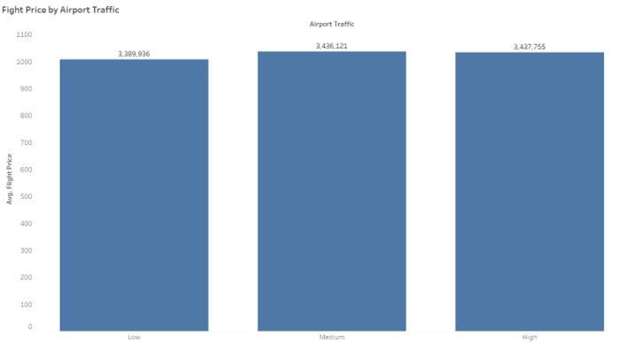
III. Exploratory Data Analysis (EDA)
Research Questions To further analyze the Spring 2024 Airline Dataset, a series of questions have been formulated based on provided statements to understand the dynamics of flight pricing.
Does airport traffic have an impact on flight prices?
Key Observations: by seeing these numbers, we can say that airport traffic impacts flight prices.

Slide 7
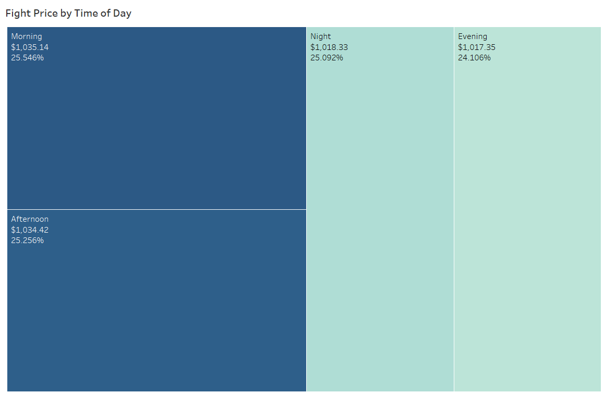
Research Questions …cont
b. Do flight prices vary by time of day?
Key Observations: There is a price difference between the time of day of the flight. Flight prices are higher in the early morning and early afternoon than in the night and evening.

Slide 8
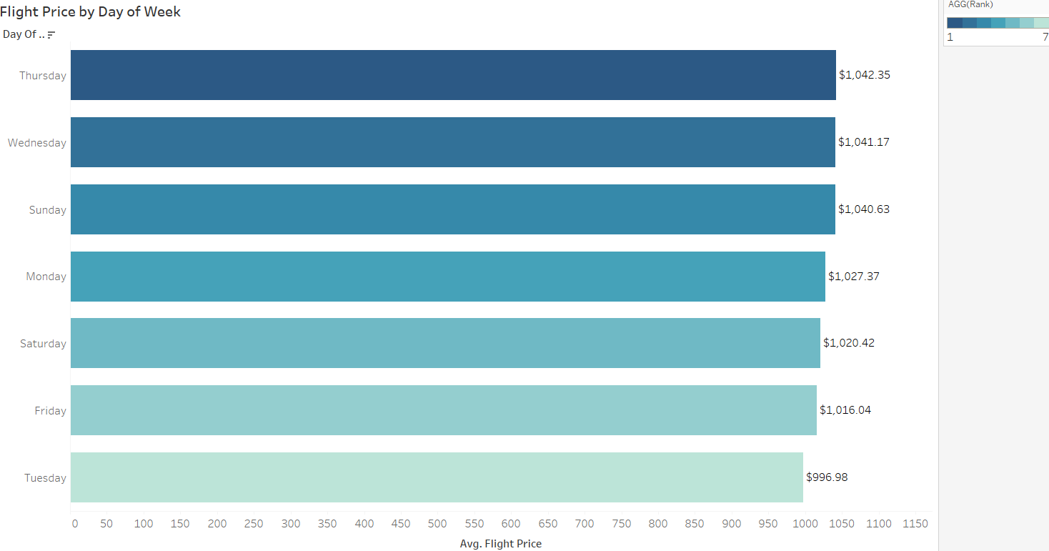
Research Questions …cont
c. Do flight prices change by day of the week?
Key Observations: The middle of the week will likely have higher flight prices, followed by the weekend and early weekdays. Tuesday and Friday are the two days when flights are at their lowest. Therefore, the day of the week also influences flight prices.

Slide 9
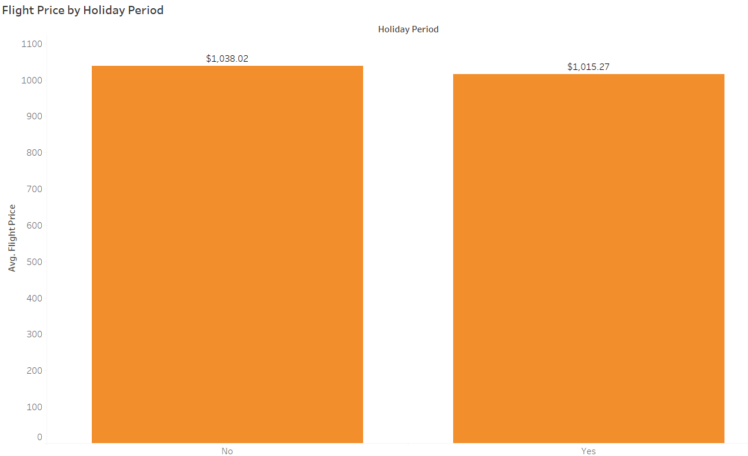
Research Questions …cont
d. What is the impact of the holiday season on flight prices?
Key Observations: The holiday season is a peak travel period in which flight demand tends to be higher than other seasons. Unfortunately, the data doesn’t show that trend; the graph shows that the flight price during the holiday period is lower than on regular days.

Slide 10
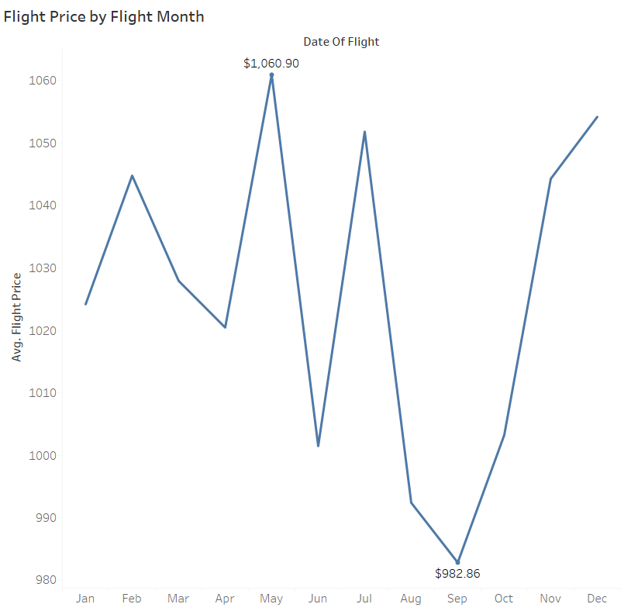
Research Questions …cont
e. Does the month of the flight affect its price?
Key Observations: The chart shows various factors, including holiday periods, seasonal demand, and airline pricing strategies, that may affect flight prices.

Slide 11
IV. Hypothesis Testing
ANOVA Testing
The following Tests are conducted with the following assumptions to be true.
The population is Normally distributed.
The population standard deviations are unknown but assumed equal.
The samples are selected independently.

Slide 12
a. ANOVA Testing …Cont.
1. Does the meaning of flight price differ significantly across airlines?
The flight prices are the dependent variable, and the airlines act as the independent, categorical variable. The purpose is to uncover if there are statistically significant differences in average flight prices among different.
Hypothesis
H₀: The Mean of flight prices do not differ significantly across airlines.
H₁: At least one airline has a significantly different mean of flight price compared to others.

Slide 13
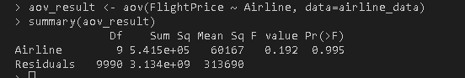
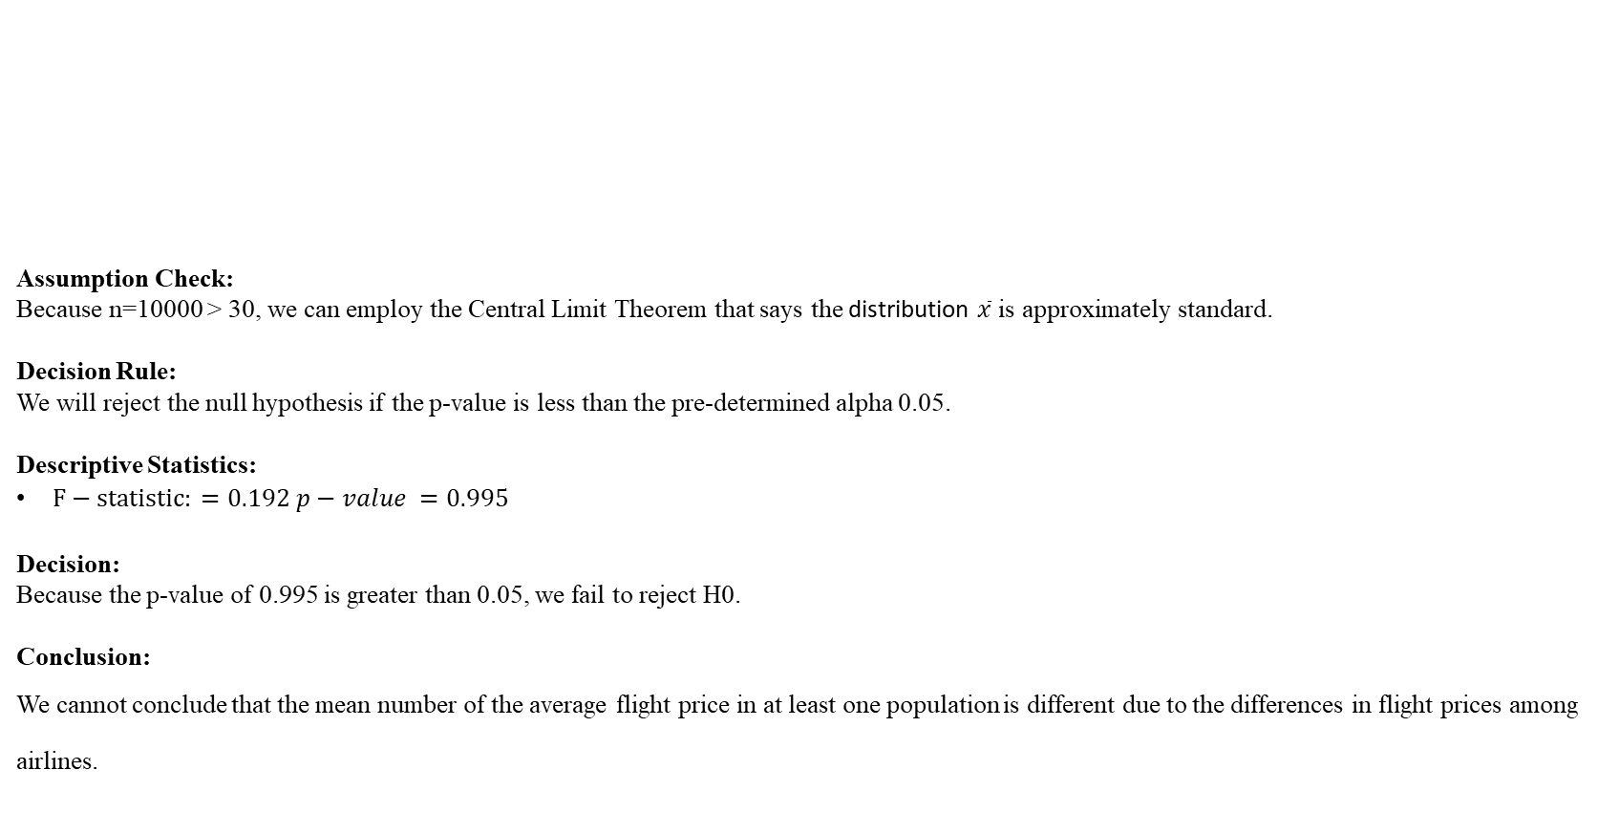
1. Does the meaning of flight price differ significantly across airlines? …Cont
Assumption Check:
Because n=10000 > 30, we can employ the Central Limit Theorem that says the distribution $\overline{x}$ is approximately standard.
Decision Rule: We will reject the null hypothesis if the p-value is less than the pre-determined alpha 0.05.
Descriptive Statistics:
$F−statistic: =0.192 p−value =0.995$
Decision: Because the p-value of 0.995 is greater than 0.05, we fail to reject H0.
Conclusion:
We cannot conclude that the mean number of the average flight price in at least one population is different due to the differences in flight prices among airlines.

Slide 14
a. ANOVA Testing …Cont.
2. Are flight prices significantly different based on the day of the week and Class Type?
This question aims to explore how pricing strategies might vary depending on the class type and weekly travel patterns if there are significant differences in flight prices on certain days of the week when comparing different classes of airline tickets.
Hypothesis:
H₀: There is no significant difference in flight prices based on the day of the week for Class Type.
H₁: There is a significant difference in flight prices on certain days of the week and Class Type.

Slide 15
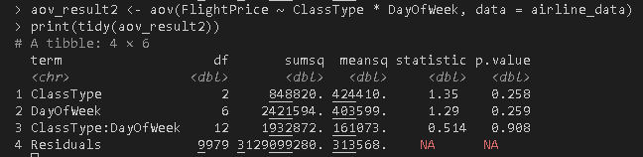
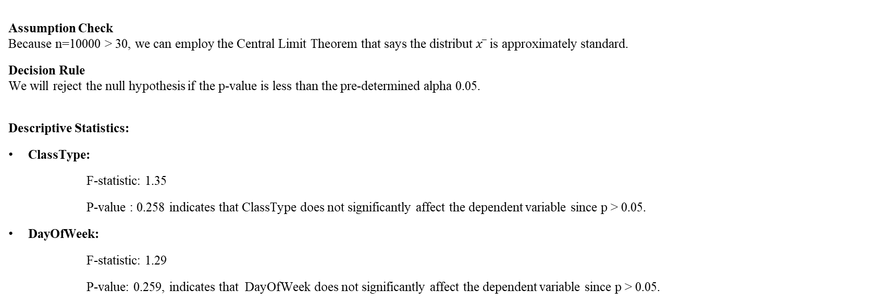
2. Are flight prices significantly different based on the day of the week and Class Type? … Cont.
Assumption Check Because n=10000 > 30, we can employ the Central Limit Theorem that says the distribut $x ̅$ is approximately standard.
Decision Rule We will reject the null hypothesis if the p-value is less than the pre-determined alpha 0.05.
Descriptive Statistics:
ClassType:
F-statistic: 1.35
P-value : 0.258 indicates that ClassType does not significantly affect the dependent variable since p > 0.05.
DayOfWeek:
F-statistic: 1.29
P-value: 0.259, indicates that DayOfWeek does not significantly affect the dependent variable since p > 0.05.

Slide 16
2. Are flight prices significantly different based on the day of the week and Class Type? … Cont.
ClassType:DayOfWeek (Interaction):
F-statistic: 0.514
P-value: 0.908, very high, strongly indicating that the interaction between ClassType and DayOfWeek does not significantly affect the dependent variable since p > 0.05.
Decision:
p-values are above the typical threshold of 0.05, we fail to reject H0.
Conclusion:
At the 5% significance level, we fail to reject H0 and conclude that there is no interaction between the ClassType and DayOfWeek or that No interaction significantly contributes to the change in flight prices based on their p-value.

Slide 17
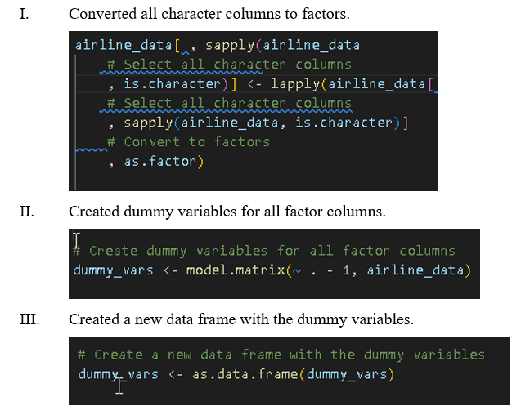
IV. Hypothesis Testing
b. Regression Analysis

Slide 18
IV. Hypothesis Testing
b. Regression Analysis
Does flight duration impact flight prices?
Explore the relationship between flight duration (independent variable) and flight prices (dependent variable). Hypothesis:
H0: Flight duration does not significantly predict flight prices.
H1: Flight duration significantly predicts flight prices.

Slide 19

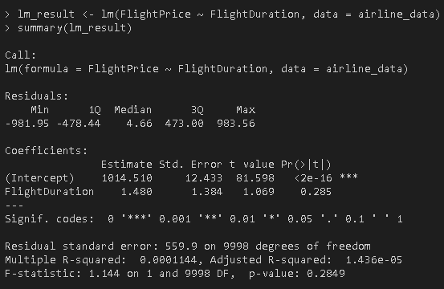
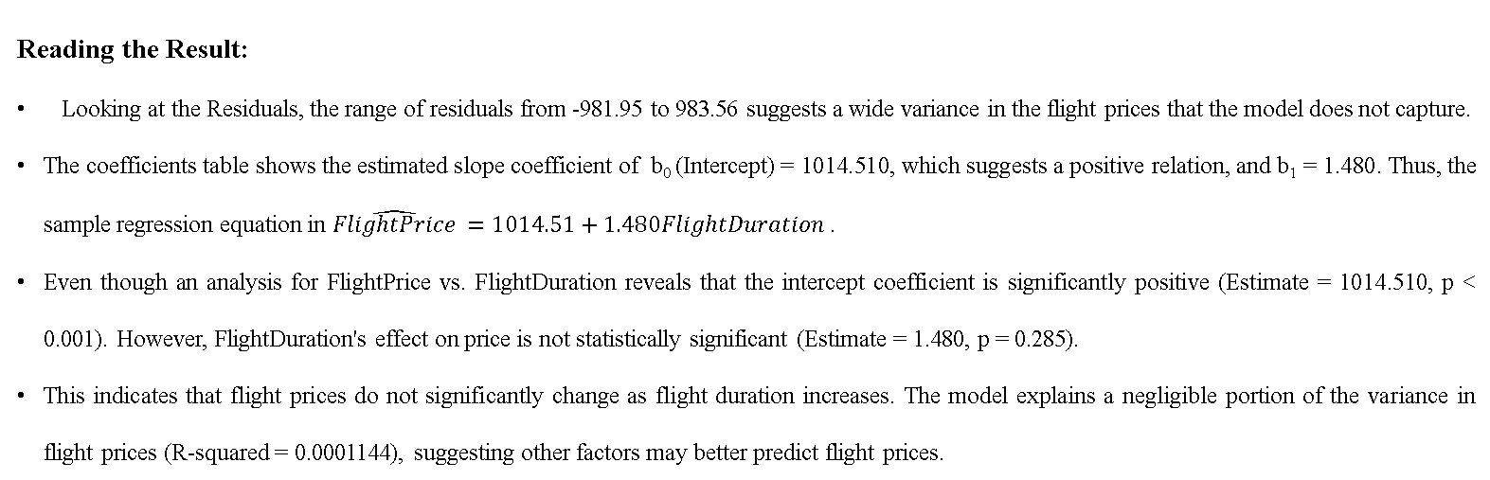
1. Does flight duration impact flight prices? …Cont.
Reading the Result:
Looking at the Residuals, the range of residuals from -981.95 to 983.56 suggests a wide variance in the flight prices that the model does not capture.
The coefficients table shows the estimated slope coefficient of b₀ (Intercept) = 1014.510, which suggests a positive relation, and b₁ = 1.480. Thus, the sample regression equation in $\hat{FlightPrice} =1014.51+1.480FlightDuration$ .
Even though an analysis for FlightPrice vs. FlightDuration reveals that the intercept coefficient is significantly positive (Estimate = 1014.510, p < 0.001). However, FlightDuration's effect on price is not statistically significant (Estimate = 1.480, p = 0.285).
This indicates that flight prices do not significantly change as flight duration increases. The model explains a negligible portion of the variance in flight prices (R-squared = 0.0001144), suggesting other factors may better predict flight prices.

Slide 20
b. Regression Analysis …Cont.
2. Do holiday seasons lead to a significant increase in flight prices compared to non-holiday?
The impact of holidays on flight prices. By comparing price spikes during holiday seasons against non-holiday, we can understand the influence of demand surges on pricing.
Hypothesis:
H0: Flight prices do not significantly vary during holiday seasons.
H1: Flight prices significantly vary during the holiday seasons.

Slide 21
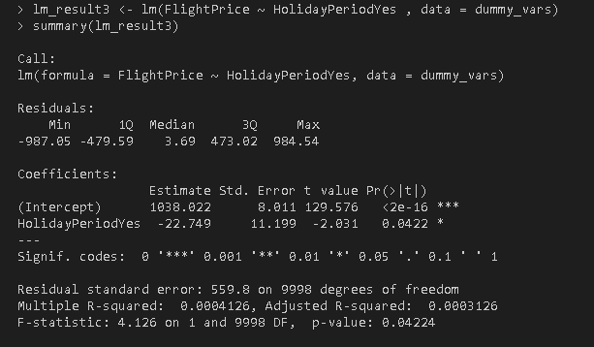
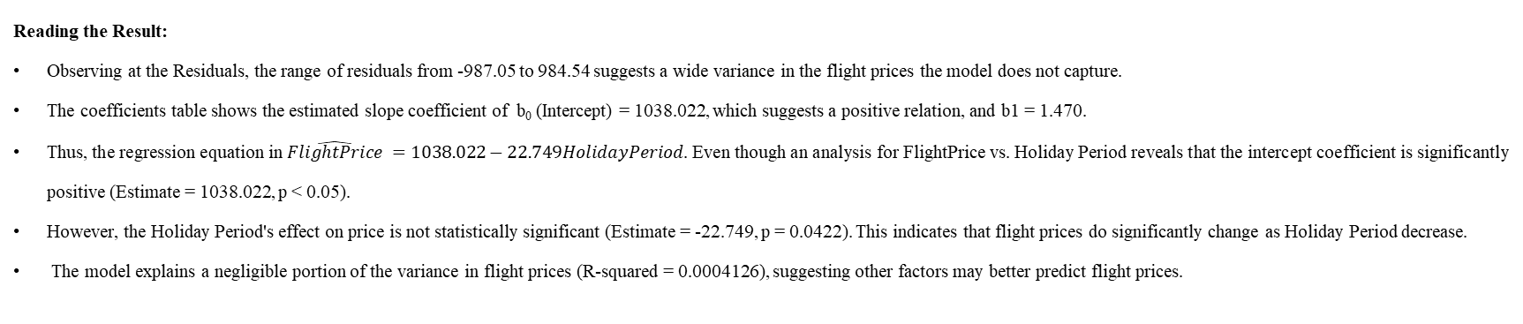
2. Do holiday seasons lead to a significant increase in flight prices compared to non-holiday? …Cont.
Reading the Result:
Observing at the Residuals, the range of residuals from -987.05 to 984.54 suggests a wide variance in the flight prices the model does not capture.
The coefficients table shows the estimated slope coefficient of b₀ (Intercept) = 1038.022, which suggests a positive relation, and b1 = 1.470.
Thus, the regression equation in $\hat{FlightPrice} =1038.022−22.749HolidayPeriod$. Even though an analysis for FlightPrice vs. Holiday Period reveals that the intercept coefficient is significantly positive (Estimate = 1038.022, p < 0.05).
However, the Holiday Period's effect on price is not statistically significant (Estimate = -22.749, p = 0.0422). This indicates that flight prices do significantly change as Holiday Period decrease.
The model explains a negligible portion of the variance in flight prices (R-squared = 0.0004126), suggesting other factors may better predict flight prices.

Slide 22
b. Regression Analysis …Cont
3. What factors best predict the price of a flight?
We will conduct various regression analyses using flight price as the dependent variable and several independent variables. Here, we try to identify which factors have the most significant impact on pricing, offering insights into pricing strategies and customer preferences.
Hypothesis:
H₀: The considered factors (flight duration, distance, time of day, day of the week) do not significantly predict flight prices.
H₁: The considered factors significantly predict flight prices.

Slide 23
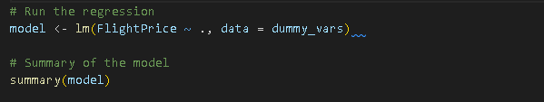
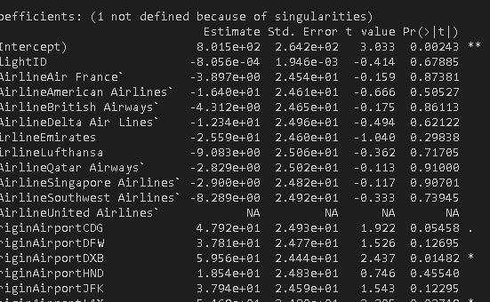
3. What factors best predict the price of a flight? … Cont.
Methodology
1. Going to fit a model with all factors with flight price as a target variable and check the model.

Slide 24
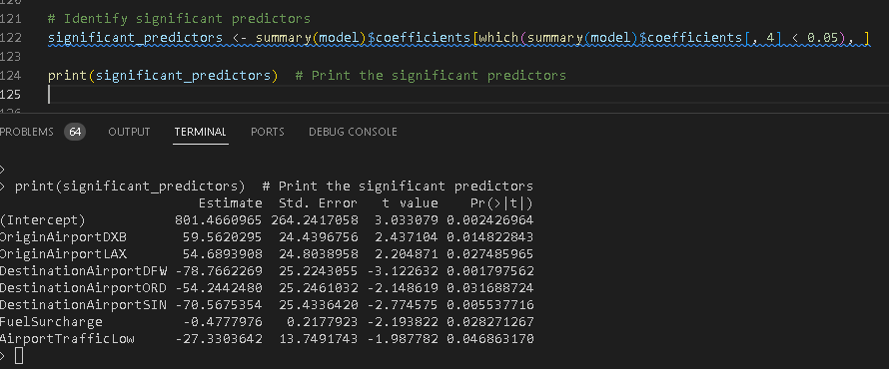
Methodology … Cont.
Identify significant Predicators with a threshold of 0.05 significance.
The result shows Hub airports like DXB, LAX, DFW, etc.; however, these cannot be used as overall price predictors unless all passengers originate from or have their destination in these locations. So, we will be refit only using Fuel Surcharge and Airport Traffic.

Slide 25
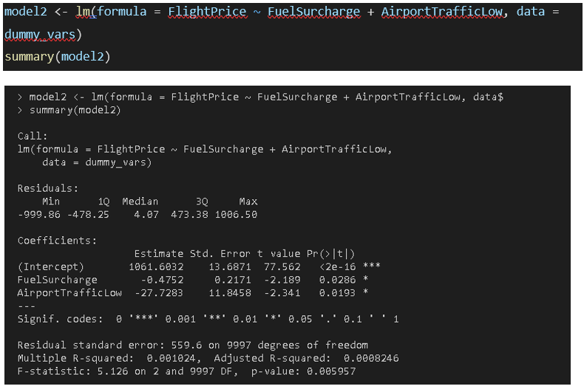
Methodology … Cont.
3. Run only with the two predictors.

Slide 26
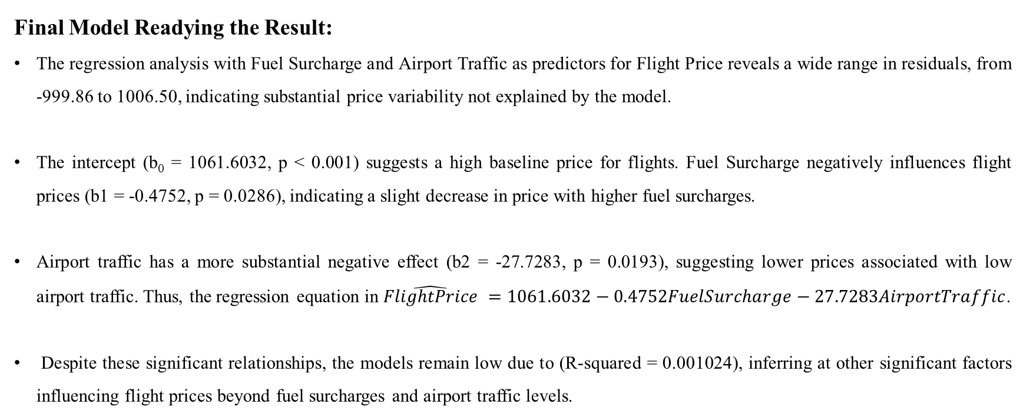
3. Run only with the two predictors …Cont.
Final Model Readying the Result:
The regression analysis with Fuel Surcharge and Airport Traffic as predictors for Flight Price reveals a wide range in residuals, from -999.86 to 1006.50, indicating substantial price variability not explained by the model.
The intercept (b₀ = 1061.6032, p < 0.001) suggests a high baseline price for flights. Fuel Surcharge negatively influences flight prices (b1 = -0.4752, p = 0.0286), indicating a slight decrease in price with higher fuel surcharges.
Airport traffic has a more substantial negative effect (b2 = -27.7283, p = 0.0193), suggesting lower prices associated with low airport traffic. Thus, the regression equation in $\hat{FlightPrice} =1061.6032−0.4752FuelSurcharge−27.7283AirportTraffic$.
Despite these significant relationships, the models remain low due to (R-squared = 0.001024), inferring at other significant factors influencing flight prices beyond fuel surcharges and airport traffic levels.

Slide 27
Reference
Juhar Ahmed Abdella, et al. "Airline ticket price and demand prediction: A survey." Journal of King Saud University - Computer and Information Sciences 33.4 (2021): 375-91. Web.
Kaplan, J. & Schlegel, B. (2023). fastDummies: Fast Creation of Dummy (Binary) Columns and Rows from Categorical Variables. Version 1.7.1. URL: https://github.com/jacobkap/ fastDummies.

Slide 28
Thank you!

